Slide 1

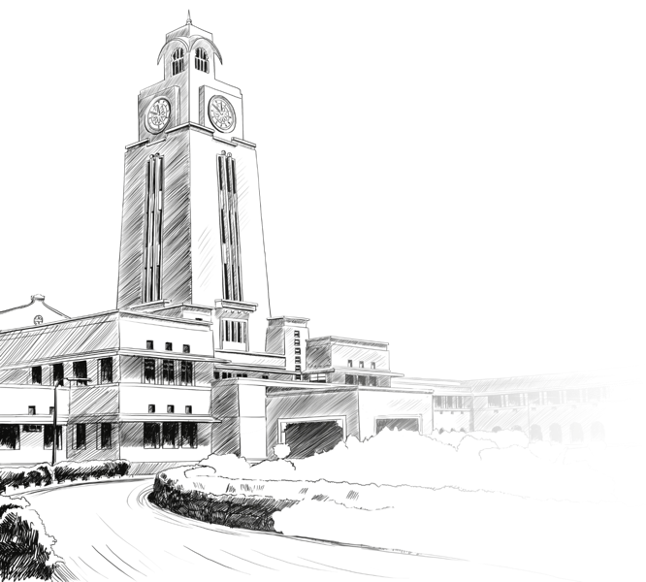

Nithin
Project Incharge
Prof. Navneet Goyal

Slide 2
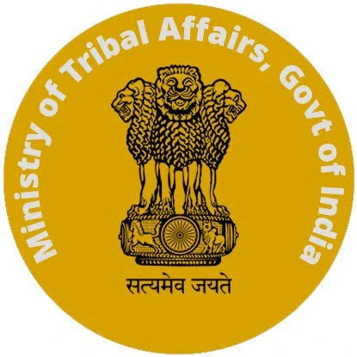
Developing AI-based language translation systems for low-resource tribal languages

Slide 3
Project Details
Project is to develop “AI-based language translation systems for low-resource tribal languages”
Project is Sponsored by “Ministry of Tribal Affairs, Govt of India”.

Slide 4
Mission
The AI-based language translation systems for low-resource tribal languages project aims to develop and implement advanced language translation technology to facilitate communication between speakers of low-resource tribal languages and speakers of other languages. The project seeks to address the issue of many tribal languages becoming extinct due to limited resources for language preservation. The translation system uses natural language processing and deep learning techniques to develop accurate and efficient translation systems for low-resource languages, which can promote greater understanding and effective collaboration across linguistic and cultural barriers.

Slide 5
Agenda
Tribal Languages in India: Endangered, Extinct and About to Extinct
Methodology
BITS Pilani

Slide 6
Tribal Languages in India: Endangered, Extinct and About to Extinct

Slide 7
Introduction
India has a rich linguistic heritage with over 19,500 languages and dialects.
Tribal languages make up a significant part of this linguistic diversity.
However, many tribal languages in India are endangered, and some have already become extinct.

Slide 8
Total Tribal Languages in India
There are an estimated 200 to 250 tribal languages in India.
These languages are classified into five linguistic groups: Andamanse, Austro-Asiatic, Dravidian, Indo-Aryan, and Sino-Tibetan.

Slide 9
Languages without any script
Bonda language
Chaudhari language
Kora language
Kuki language

Slide 10
Languages using other scripts
23 of the majorly spoken tribal languages has scripts
Banjari language (Devanagari script or Telugu script)
Bhil language (Devanagari script)
Bodo language (formerly Assamese or Latin alphabets, currently Devanagari)
Chenchu language (Telugu script)
Dhodia language (Devanagari script)
Gamit language (Devanagari, Gujarati scripts)
Garo language (Chik Tokbirim script)
Gondi language (Gunjala Gondi lipi or Gunjala Gondi script)
Halbi language (Odia and Devanagari scripts)
Ho language (Devanagari, Latin script, Odia script, Telugu script)
Irula language (Tamil script)

Slide 11
Karbi language (Roman script in Karbi Anglong and Dima Hasao districts of Assam, Meghalaya, and Arunachal Pradesh, and Assamese script in Kamrup district of Assam)
Khasi language (Latin and Bengali-Assamese scripts)
Kokborok language (Bengali and Latin scripts)
Kui language (Odia script)
Kurukh language (Devanagari and Tolong Siki script)
Mizo language (Latin and Bengali-Assamese scripts)
Mundari language (Mundari Bani script, Devanagari, Odia, Bengali, and Latin writing systems)
Paniya language (Kannada, Malayalam, and Tamil scripts depending on location)
Santali language (Ol Chiki script)
Tharu language (Devanagari script)
Varli language (Latin and Devanagari scripts)
Vasavi language (Devanagari and Gujarati scripts)

Slide 12
Extinct languages in India
7 tribal languages in India have already become extinct.
These languages are Ahom, Andro, Rangkas, Sengmai, Tolcha, Tai Ahom, and Tai Turung.
These languages were spoken in the Himalayan belt and Assam.

Slide 13
Languages about to extinct in India
42 tribal languages in India are currently endangered according to UNESCO's 2018 report.
These languages are spoken in various states of India.
The list includes:
Andaman and Nicobar Islands: Great Andamanese, Jarawa, Lamongse, Luro, Muot, Onge, Pu, Sanenyo, Sentilese, Shompen, and Takahanyilang
Manipur: Aimol, Aka, Koiren, Lamgang, Langrong, Purum, and Tarao
Himachal Pradesh: Baghati, Handuri, Pangvali, and Sirmaudi
Odisha: Manda, Parji, and Pengo
Karnataka: Koraga and Kuruba
Andhra Pradesh: Gadaba and Naiki

Slide 14
The list includes:
Tamil Nadu: Kota and Toda
Arunachal Pradesh: Mra and Na
Assam: Tai Nora and Tai Rong
Uttarakhand: Bangani
Jharkhand: Birhor
Maharashtra: Nihali
Meghalaya: Ruga
West Bengal: Toto

Slide 15
Note:
150 languages could vanish in the next 50 years (as estimated by Ganesh Narayan Devy, founder-director of the Bhasa Research and Publication Centre)
Note: According to UNESCO, any language spoken by less than 10,000 people is potentially endangered.

Slide 16
Datasets
Meta has already open-sourced a corpus of English to Santali translations.
For other languages, there are dictionaries of tribal languages available on a few websites.
Note: The Santhali language is India's largest tribal language and is spoken by close to 6 million people.

Slide 17
Languages with OCR
Tesseract OCR contains Ol Chiki (Santali) and Meetei Meyek (Manipuri) scripts

Slide 18
Importance of preserving tribal languages in India
Tribal languages are an integral part of India's cultural and linguistic diversity.
These languages hold valuable information about the history, culture, and traditional knowledge of the tribes.
Preserving these languages is crucial for maintaining the cultural identity of these tribes and promoting linguistic diversity in India.

Slide 19
Efforts to preserve tribal languages in India
Various organizations, government agencies, and individuals are working towards preserving and promoting tribal languages in India.
Some of the initiatives include creating language documentation, developing language-learning resources, and providing language revitalization programs.
These efforts are aimed at safeguarding the rich linguistic heritage of India's tribal communities.

Slide 20
Conclusion
The diversity of languages and dialects in India is immense, and tribal languages make up a significant part of this diversity.
However, many of these languages are endangered, and some have already become extinct.
Preserving and promoting these languages is crucial for maintaining the cultural identity of India's tribal communities and promoting linguistic diversity in the country.

Slide 21
Methodology

Slide 22
Approach
One approach is to use transfer learning, where models trained on similar languages or tasks are fine-tuned for the low resource language. For example, a model trained on Hindi or Tamil may be fine-tuned on a low resource language that uses the same script (Like Devanagari or Sanskrit). Another approach is to use unsupervised or semi-supervised learning techniques that do not require large amounts of labeled data.
Another option is to collect and annotate data for the low resource language. This can be done through crowd-sourcing or by working with speakers of the language to create datasets for training and evaluation. While this approach can be time-consuming and resource-intensive, it can lead to better performance for NLP tasks in the long run.

Slide 23
Steps
Building a neural machine translation (NMT) system for low resource languages can be challenging, but it can be done by following a systematic methodology. Here is a methodology you can follow to build an NMT system for low resource languages:
1. Data Collection: The first step is to collect parallel data for the source and target languages. Parallel data refers to text in the source and target languages that have a one-to-one correspondence. You can collect this data through various sources, such as websites, books, articles, or by working with native speakers of the languages.

Slide 24
Followed by
2. Custom Tokenizer Creation: If there are no readily available tokenizers for the low resource language, you can create a custom tokenizer. Tokenization involves breaking down the text into tokens or units for further processing, such as training an NMT model. Creating a custom tokenizer for a low resource language involves the following steps:
- Determine the tokenization strategy: Decide on the tokenization strategy that best suits the language, such as word-based, character-based, or subword-based tokenization. The tokenization strategy will depend on the characteristics of the language, such as its morphology and orthography.
- Collect the data: Collect a sufficient amount of data in the low resource language. This data will be used to train the custom tokenizer.
- Preprocess the data: Preprocess the data by cleaning it and performing any necessary normalization, such as converting the text to lowercase or removing punctuation.

Slide 25
Followed by
- Train the tokenizer: Train the tokenizer on the preprocessed data. You can use existing tokenization libraries, such as NLTK or spaCy, or build your own tokenizer from scratch using Python or another programming language.
- Test the tokenizer: Test the tokenizer on a small subset of the data to ensure that it is producing the desired output. You may need to fine-tune the tokenizer parameters or make adjustments to the tokenization strategy based on the test results.
- Preprocess the data: Preprocess the data by cleaning it and performing any necessary normalization, such as converting the text to lowercase or removing punctuation.
Note: Creating a custom tokenizer can help improve the quality of the NMT model by producing more accurate and relevant tokens for training. However, creating a custom tokenizer can be time-consuming and resource-intensive, and may not be necessary for all low resource languages.

Slide 26
Followed by
3. Data Cleaning and Preprocessing: Once you have collected the parallel data, the next step is to clean and preprocess it. This involves removing noise, formatting the data, and converting it into a format suitable for NMT. You may also need to perform language-specific preprocessing, such as tokenization, stemming, and stop word removal.
4. Training Data Preparation: The parallel data needs to be split into training, validation, and test sets. The training set is used to train the NMT model, the validation set is used to tune the hyperparameters, and the test set is used to evaluate the performance of the model.
5. Model Training: The next step is to train the NMT model on the training data. There are various NMT architectures, such as Transformer, LSTM, and GRU, that can be used for this purpose. You can use open-source NMT frameworks, such as OpenNMT and Tensor2Tensor, to train your NMT model.

Slide 27
Followed by
6. Model Tuning: After training the NMT model, you need to tune the hyperparameters to optimize the performance. This involves experimenting with various hyperparameters, such as learning rate, batch size, and dropout rate, and selecting the ones that give the best performance on the validation set.
7. Model Evaluation: The final step is to evaluate the performance of the NMT model on the test set. This involves measuring the quality of the translations using various metrics, such as BLEU, METEOR, and TER. You can use open-source evaluation tools, such as SacreBLEU and TER-Plus, to evaluate your NMT model.

Slide 28
Followed by
In addition to the above steps, there are some other considerations that you need to keep in mind while building an NMT system for low resource languages. These include:
Handling out-of-vocabulary words and rare words
Dealing with data sparsity and data imbalance
Addressing issues related to low-resource languages, such as lack of standardized spelling and script variations
Overall, building an NMT system for low resource languages requires careful data collection, preprocessing, and training, along with the use of appropriate tools and techniques.

Slide 29
Thank you

